Slide 1
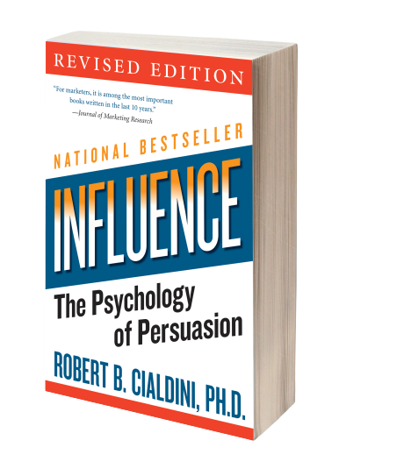
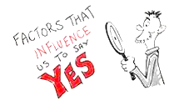
6 Universal Principals -
To be deployed in an ethical manner

Slide 2
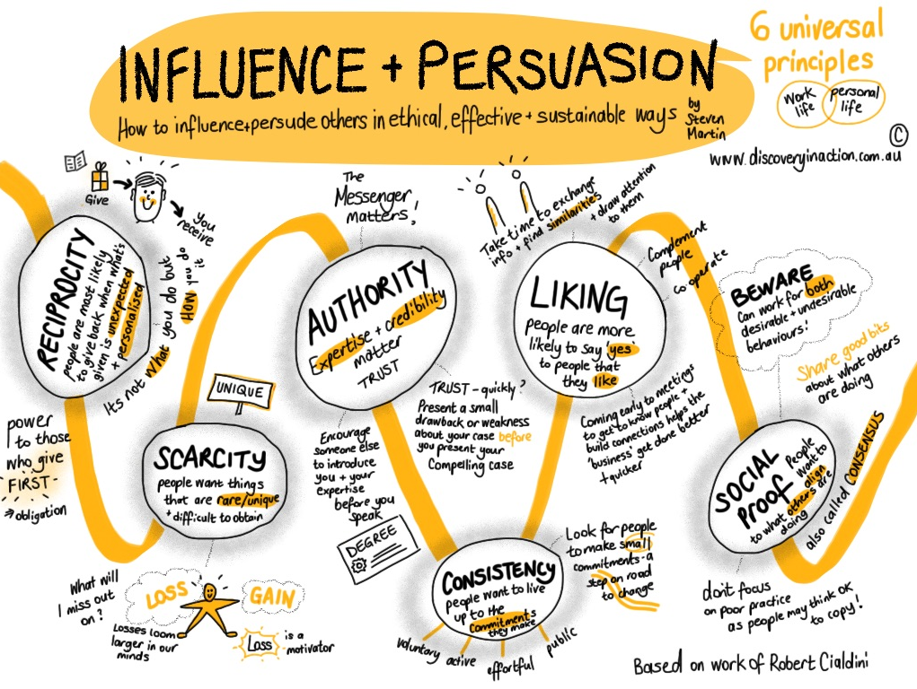
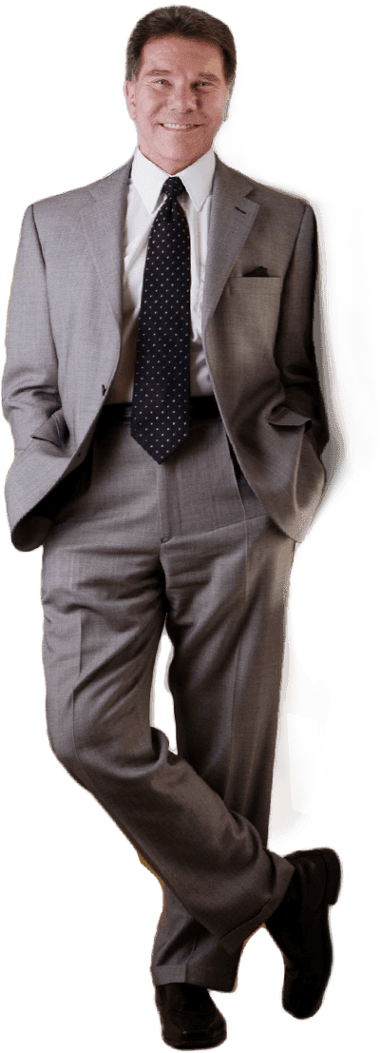

Slide 3
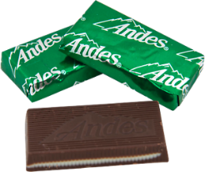
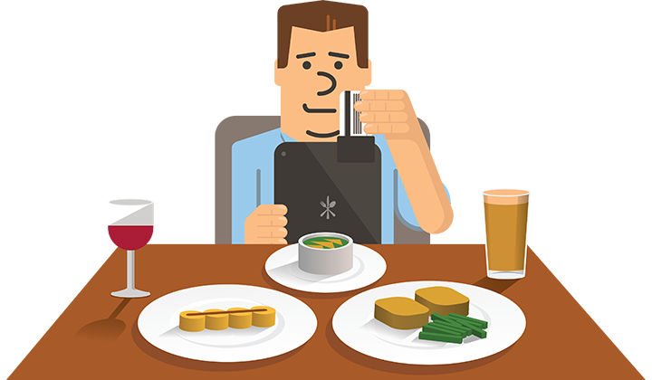
Principle 1 - Reciprocity
The internal pull to repay what another person has provided us.
Be the first to give AND what you give needs to be personalized and unexpected.
If you want something from someone, offering them something small for free will often lead to a bigger reciprocal response.
Receiver likely to:
Have a feeling of obligation to listen to what they have to say
Feel favor for favor
Say “yes” to those they feel they owe
Giving diners a single mint at the end of the meal increased tips 3%, 2 mints and tips quadrupled to 14% increase, but if the server leaves one mint walks away and turns back around and says, to you nice people, ‘here’s a second mint’ – an increase of 23% was returned.

Slide 4
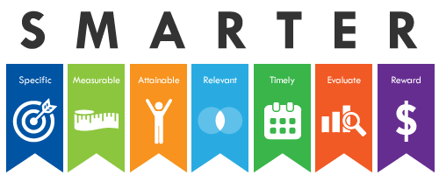
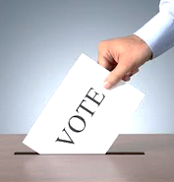
Principle 2 - Commitment and Consistency
Once we make a choice or take a stand, we work to behave consistently with that commitment in order to justify our decisions.
People will typically do something if they’ve agreed to it verbally or in writing.
Writing your goals or telling your friends will make you more likely to follow through.
Desire to be consistent with what we’ve said we would do.
Poll takers would call and start the conversation by asking if people would be voting in the next election… they will vote less often if they hadn’t received the call to commit.

Slide 5
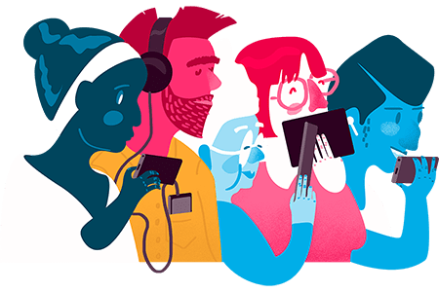
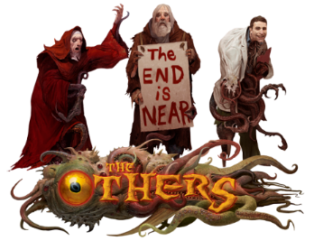
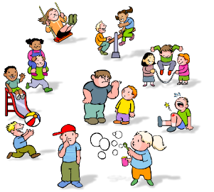
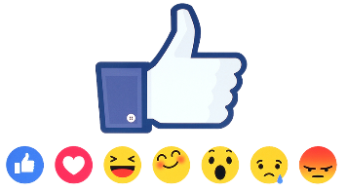
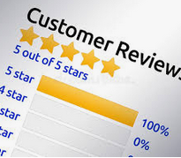
Principle 3 – Social Proof
When we are unsure, we look to similar others to provide us with the correct actions to take. And the more, people undertaking that action, the more we consider that action correct.
We view a behavior as more correct in a given situation to the degree that we see others doing it. The more the number of people doing it, the more the rule works into making us believe that the behavior is correct. We use behavior of people (like us) to determine proper behavior for ourselves.
Canned laughter (laughing track) causes viewers to laugh longer and more often.
Bartenders seed their tip jars with a few dollars to give the impression that tipping is the norm.
The Massacre of Jonestown – people, followed each other to drink poison and committed mass suicide. They were in a new place, and they just followed what fellow members (like them) did.
Kids learn more about their capabilities from other children than from adults.
Werther effect – a front-page suicide story leads to 58 more unusual suicides in the following month.

Slide 6
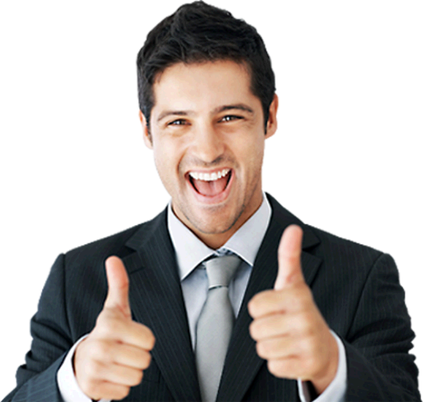
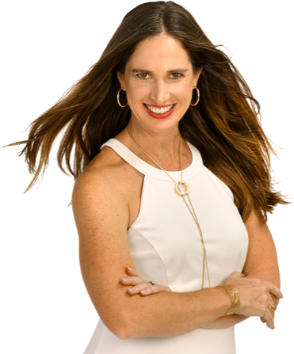
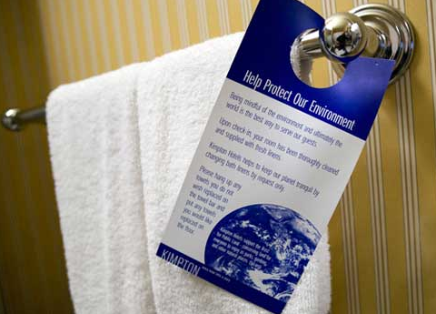
Principle 4 – Liking
The propensity to agree with people we like and, just as important, the propensity for others to agree with us, if we like them.
People prefer to say “yes” to those they know and like.
People attribute traits such as honesty, talents, intelligence to attractive people. We gravitate to those with similar views, interests, values. Find areas of shared interest.
We like people who are similar to us, who pay us compliments, who cooperate with us on future goals.
Start by finding similarity with the individuals – genuine compliments before getting to business.
Experiment: Cards were left in hotel bathrooms attempting to persuade reuse of towels
“Most people reuse their towels at least once during their stay.” 26% more likely
“Most people who have stayed in this room reuse their towels at least once during their stay.” 33% more likely
Take Away: Don’t rely on our own ability to persuade others – use science.

Slide 7
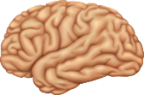
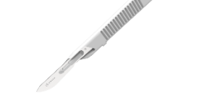
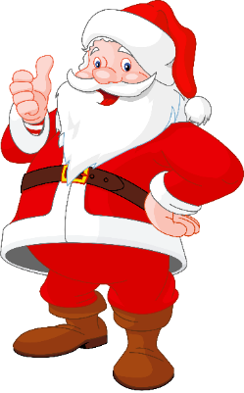
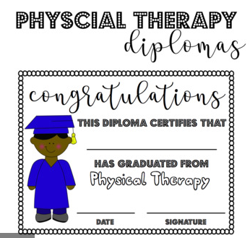
Principle 5 – Authority
We are more likely to say “yes” to others who are authorities, who carry greater knowledge, experience or expertise.
People follow the lead of credible, knowledgeable experts.
Santa suit brain surgeon – wouldn’t trust.
Signal to others what makes you a credible knowledgeable authority before you make your influence attempt. OR have others sing your praises with an expert led introduction. Such as 'So and so has 15 years experience….'
When hospital physical therapists displayed their authority/diplomas on the wall, compliance of people following through with their therapy increased 30%.

Slide 8
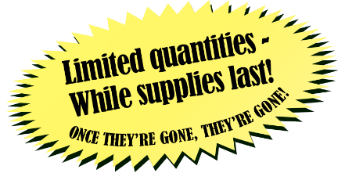
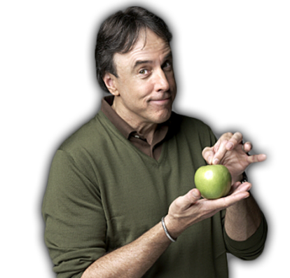
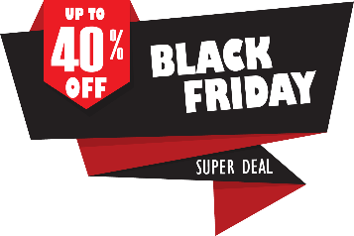
Principle 6 – Scarcity
The propensity to agree with people we like, and just as important, the propensity for others to agree with us, if we like them.
People want more of the things they think they can have less of.
The scarcity of an item indicates that the item should be better. This is why sales are for a limited time only. Time is scarce and increases value.
The thought of losing somethings scares us more than thought of gaining something of similar value.
Is it genuinely a unique or dwindling opportunity? The influencer must point out what is unique and what others stand to lose if they don’t act.
Personal Example
My wife and I recently saw comedian Kevin Nealon’s standup in Nashville. He booked ONE show ONLY and sold out the venue. Towards the end of his set he said goodnight and walked off the stage - - but then he came back and did a bit more standup. He repeated this behavior several times and each time the audience was more engaged and cheered louder for him to return to the stage.
Think of some others such as Cyber Monday and Black Friday….

Slide 9
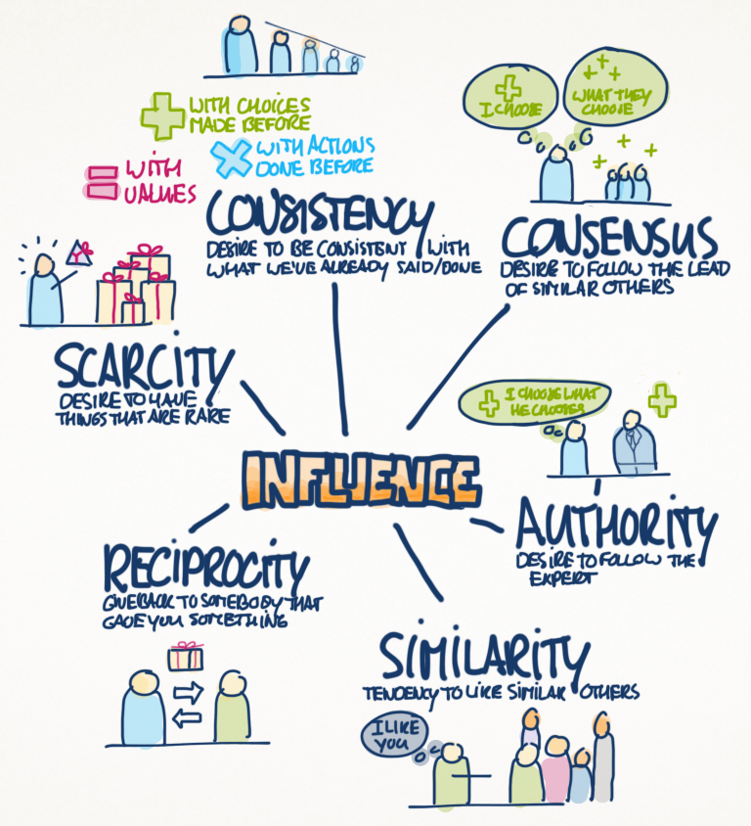

Slide 10
What is your opinion of the book?

Slide 11
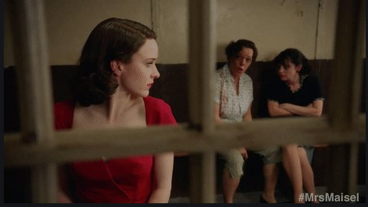
“I’d listen to her, she looks like she knows what she’s talking about.”

