Slide 1
Accountability Teams “Holding Each Other Accountable”
Embracing Accountability
Notes:
This is not management level accountability, it is self or within team accountability. Share and stress this point.
I had an employee say they are not their colleages’s supervisor so how can they “hold them accountable”? This is where this exercise and related sessions will help define and educate.

Slide 2
Create Accountability Teams
Hold regular meetings to openly discuss and get feedback on what was learned
<for example>Feedback: Some are doing great, some have challenges
How do you solve challenges?
Purpose: To ensure we reach our goals; help each other. We are a team
Tools to Leverage and How:
Utilize 5 Dysfunction of a Team and Systems Thinking tools
Best practices: Harvest Conflict – challenge each other
See following slides
Communication: Constructive Criticism, be open and be each others worst critic
This will help with the continuous improvement we all need to work on.
Systems Thinking:
i.e. Iceberg. As a team member, you are in an excellent position to ask the probing questions, offer a different set of lenses.
Notes:
Divide the team members into groups or teams and make them an Accountability Team.
Make it fun and have them create a name for their team. More challenging and competitive.

Slide 3
Overcoming the 5 Dysfunctions of a Team
Embracing Accountability

Slide 5
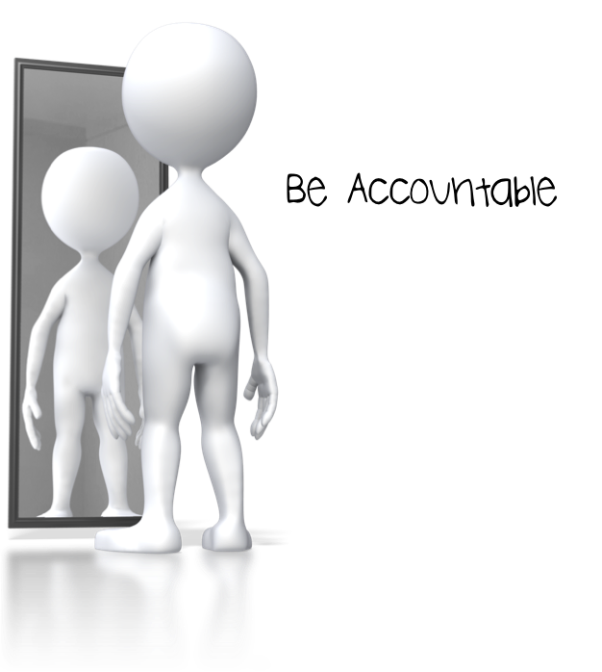
The need to avoid personal discomfort prevents team members from holding one another accountable for their behaviors.

Slide 9
Notes:
Utilize a Trust Survey – share and go over the results

Slide 10
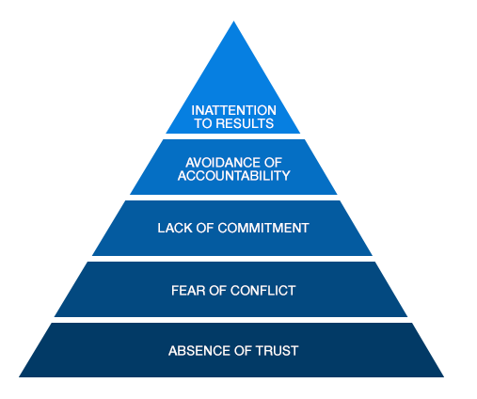
Mastering Conflict
Notes:
Share with team:
Conflict is not a knock down drag out fight; it is productive, ideological, passionate debate around important issues.
To have this type of conflict requires vulnerability-based Trust
Mastering Conflict leads to a humble pursuit of truth rather than destructive personal attacks and ego building

Slide 11
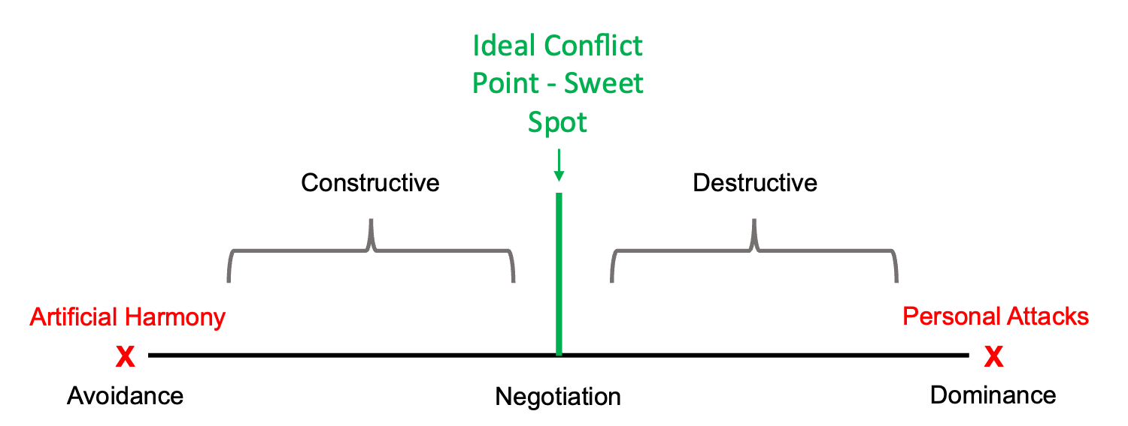
Conflict Continuum
Notes:
Ideal Conflict Point lies between Artificial Harmony and Mean-Spirited Personal Attacks
It requires that team members are pushed outside of their comfort zone
It requires that team members be somewhat uncomfortable
Your Team lacks conflict if you are leaving a meeting:
feeling like you have something you should have said
thinking “oh well, my opinion wouldn’t have mattered anyway”
Never lets others speak

Slide 12
Accountability applies to all levels: team level, manager level, director level, etc.
Accountability on a strong team occurs directly among peers.
The best opportunity to hold one another accountable occurs during regular meetings.

Slide 13
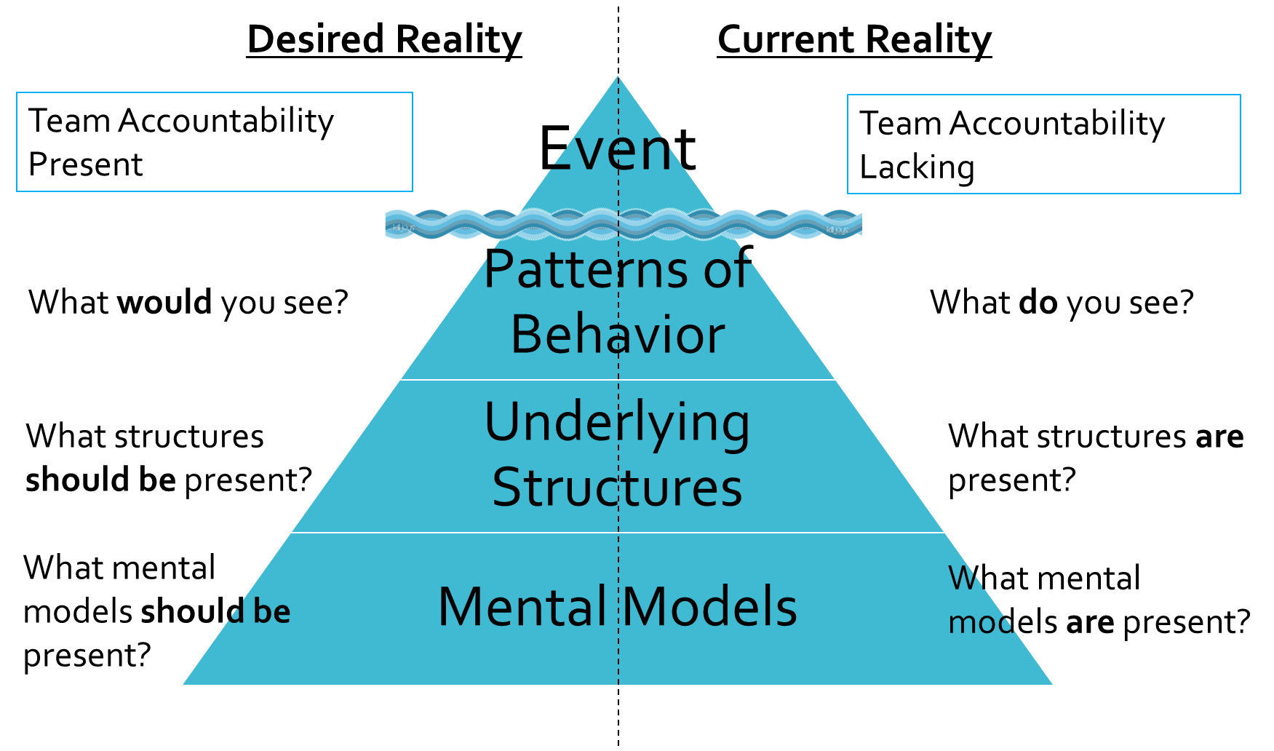

Slide 14
Next Steps, Action Items:
Accountability Team and Continuous Improvement
Meet 1 time per month. Stress the importance and value of the meetings.
Let team members know that it is a requirement to attend and schedule your work around them.
Set an agenda for each meeting – have each member share out progress of one or two goals.
Help with ways of monitoring goals and talk about success and area of improvement(s)
Create a communication system – check-ins (email, phone calls, etc.) with timelines. Follow and stick with it!

