Slide 1
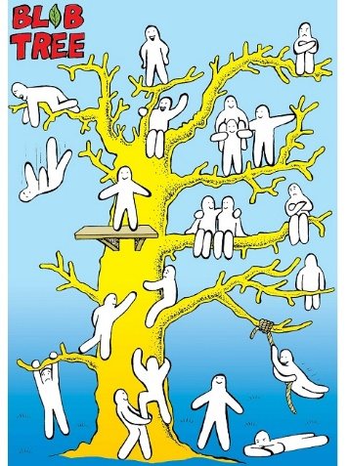
Notes:
Have someone READ it
Ask them to start to think About:
--> why is that important?
--> how does that help us as we communicate as a team or towards team members?
We will go into it more in depth in just a second…

Slide 2
Which Blob do you feel like today?
Why do you feel like that?
Which Blob would you like to feel like?
Which Blob do you feel like when you come to work?
Which Blob do you feel like when you are with other team members while at work?
Which Blob do you feel like when you are with your friends?
Which Blob do you feel like when you are with teachers or site admins at work?
Which Blob do you feel like when you are with your family - mom/dad, bothers/sisters?
Notes:
Take 2-3 minutes and pick a blob for each question
But each person gives a response to at least 1 question and why they picked that blob
This is meant to be informative but also fun
<ASK>
Why did we do this?
To help us identify our feelings and attitudes at varying points throughout our day and our various activities
If we can identify how we feel more easily, we can begin to adjust our attitudes accordingly to become better communicators, learn, and be able to collaborate easier with our other team members.
Here is an example of how we can identify our current feelings and why this is important…

Slide 3
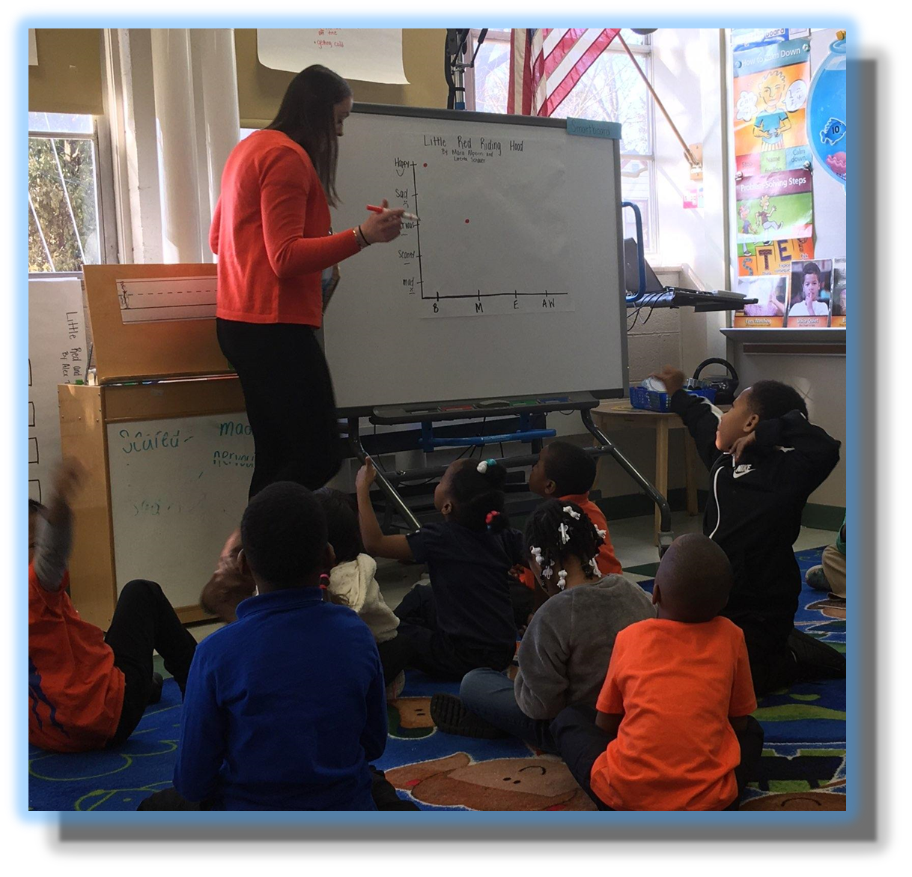
They Now Analyze Information Differently
Heard Before,
but
never recognized
New Aspects
which
expands their thinking
and
hearing others
New Concepts
and
how to process them
New Feelings
And
what to do with them
New Thoughts and Actions
and
natural consequence
Notes:
Systems Thinking – here are kindergarteners identifying, sharing, and discussing feelings about the story “Little Red Riding Hood”
How often have you been talking with someone and you felt your message was not getting across or they were just not listening?
By being able to look at the blob tree, it might help us get to the root cause.
Or look at things you have seen and heard so many times before, now you see it in a different or whole new way or perspective

Slide 4
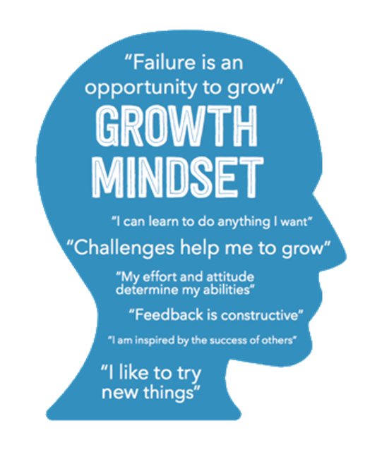
Why is Attitude Important
Notes:
READ: Attitudes are rooted in one's own beliefs and are unique ….
READ: Fixed mindset …
Growth mindset …
Recent Stanford study shows that ATTITUDE is a better predictor of success than your IQ
Think about it – having a better attitude could be a greater driver for success than your IQ…
Abraham Lincoln
Dr. James Watson – Noble-Prize for coming up with the structure of DNA
Ronald Reagan
Albert Einstein – 160
Stephen Hawking – 160
Bill Gates – 160
Nikola Tesla – 190-310

Slide 5
Given we have;
ABCDEFGHIJKLMNOPQRSTUVWXYZ
And each letter has a numeric value;
1,2,3,4,5,6,7,8,9,10,11,12,13,14,15,16,17,18,19,20,21,22,23,24,25 and 26
Notes:
Fun little exercise that shows us how important Attitude is

Slide 6
Given we have;
ABCDEFGHIJKLMNOPQRSTUVWXYZ
And each letter has a numeric value;
1,2,3,4,5,6,7,8,9,10,11,12,13,14,15,16,17,18,19,20,21,22,23,24,25 and 26
Then KNOWLEDGE equals what number?
K N O W L E D G E
11+14+15+23+12+5+4+7+5
=
96%
Notes:
96%

Slide 7
Given we have;
ABCDEFGHIJKLMNOPQRSTUVWXYZ
And each letter has a numeric value;
1,2,3,4,5,6,7,8,9,10,11,12,13,14,15,16,17,18,19,20,21,22,23,24,25 and 26
Then HARDWORK equals what number?
H A R D W O R K
8+1+18+4+23+15+18+11
=
98%
Notes:
98%

Slide 8
Then KNOWLEDGE and HARDWORK are important but do not get us to 100%
K N O W L E D G E = 96%
H A R D W O R K = 98%

Slide 9
Given we have;
ABCDEFGHIJKLMNOPQRSTUVWXYZ
And each letter has a numeric value;
1,2,3,4,5,6,7,8,9,10,11,12,13,14,15,16,17,18,19,20,21,22,23,24,25 and 26
Then ATTITUDE equals what number?
A T T I T U D E
1+20+20+9+20+21+4+5
=
100%
Notes:
100%

Slide 10
https://youtu.be/pTgOLLmTQI0
Notes:
Edit the length of the video to cut out the commercial part of it.

Slide 11
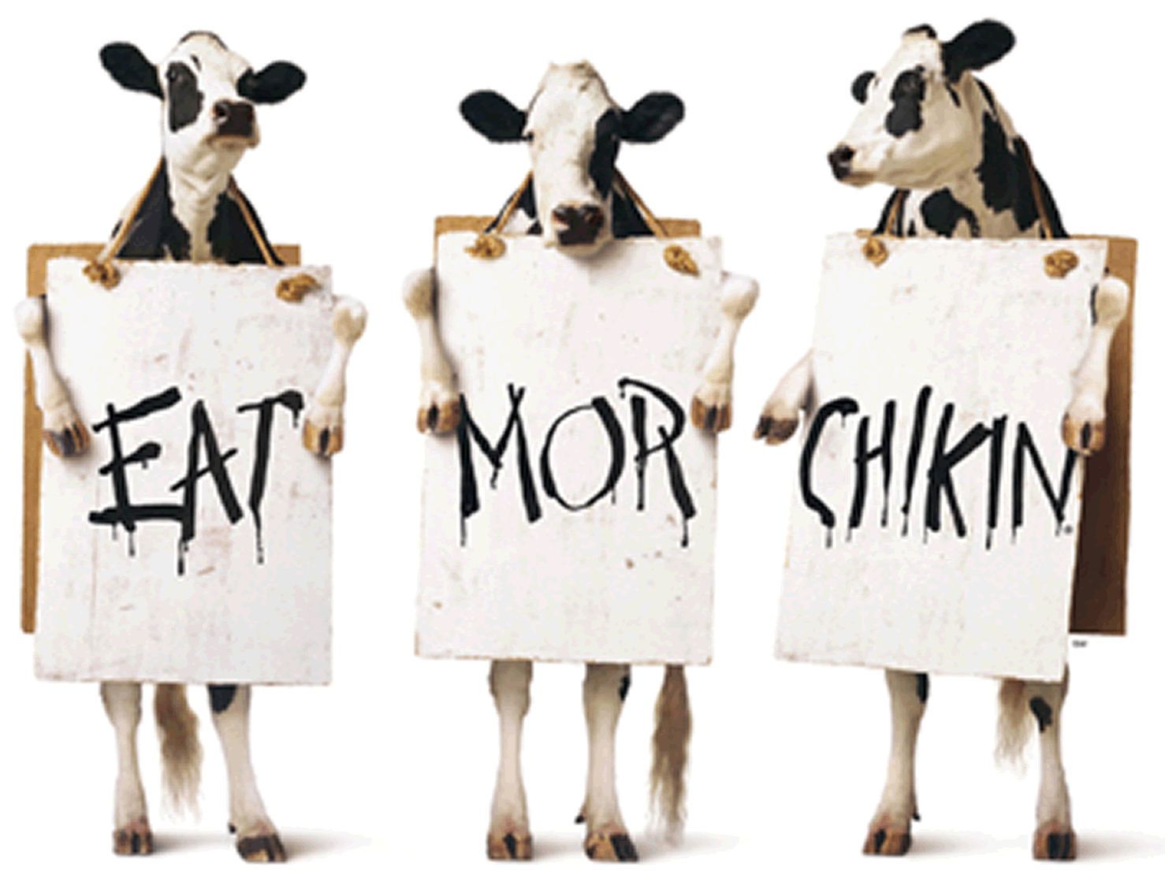
How does my work impact others
How does your work impact others' lives, make a difference in someone's life?
Notes:
At the end of the day and why we have been spending time on this as a team –
Humans are made to server others. We all need to help and serve others. If we don't, then we begin to die emotionally.
Team exercise
Why are we doing what we do?
How does your work impact others?
Have them get in teams and write down what they came up with.
Put on big paper
Look at In-And-Out Burgers or Chick-fil-A - their employees are young kids and they are all happy, energetic, and it is infectious. That stems from a culture of caring of good management. Their management helps their employees to know how their work impacts others (smiles, fast and good orders fulfilled, etc.).
In 2017 - Chick-fil-A has more store sales than McDonald’s and KFC combined and achieved 49 consecutive years of sales growth.

Slide 12
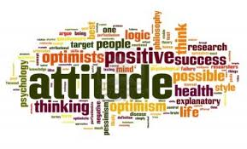
Attitudes are rooted in one's own beliefs and are unique across most individuals.
Moreover, certain attitudes create a negative impact to one's life and may even cause it to fall apart.
This is why it is an important task for each person to help themselves take on the proper attitude direction.
One of the most important steps you can take toward achieving your greatest potential in life is to learn to monitor your attitude and its impact on your work performance, relationships and everyone around you.

Slide 13
With a fixed mindset, you believe you are who you are and you cannot change. This creates problems when you're challenged because anything that appears to be more than you can handle is bound to make you feel hopeless and overwhelmed.

Slide 14
People with a growth mindset believe they can improve with effort. They outperform those with a fixed mindset, even when they have a lower IQ, because they embrace challenges, treating them as opportunities to learn something new.

