Slide 1
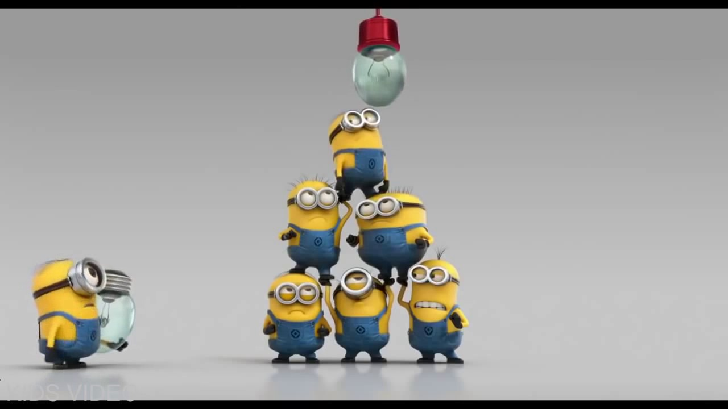
Welcome –Staff Meeting

Slide 2
The DiSC profile is a non-judgemental tool used for discussion of people's behavioral differences.
The DiSC model provides a common language that people can use to better understand themselves and adapt their behaviors with others.
https://youtu.be/0Rl9Cxc7uZA
Notes:
Common Language – we need it
We all know about that right when someone speaks a foreign language, we laughing speak louder thinking that will help them understand you.
We need a common language to be productive, to get RESULTS

Slide 3
Notes:
Ok, who took the DISC test?
Make them stand up based on the DISC.

Slide 4
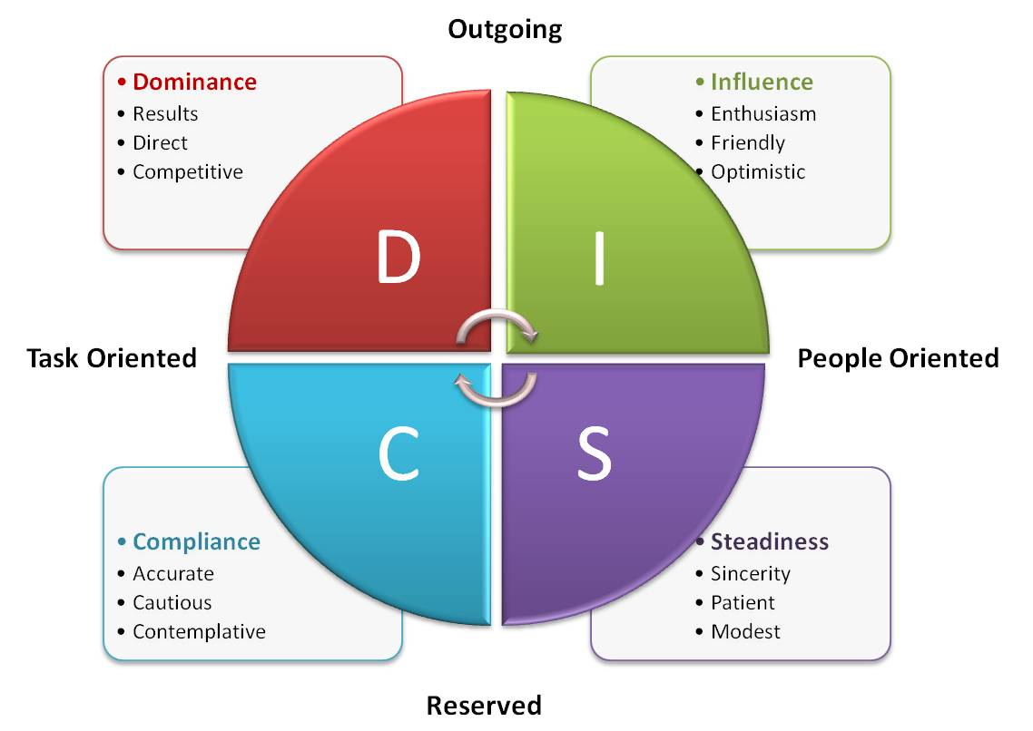
Notes:
Do you remember your result?

Slide 5
What did YOU learn?

Slide 6
